Slide 1
The Team Meeting
Prof. Dr. Dirk Riehle
Friedrich-Alexander University Erlangen-Nürnberg
AMOS B02
Licensed under CC BY 4.0 International
Notes:
It is Friedrich-Alexander University Erlangen-Nürnberg – FAU, in short.
Corporate identity wants us to say “Friedrich-Alexander University”.

Slide 2
The Scrum Sprint (Recap)
Wed
Thu
Mon
Tue
09:00
Sprint
planning
Daily Scrum
Daily Scrum
Daily Scrum
...
Product management
Software development
Process improvement
Product management
Software development
Process improvement
Product management
Software development
Process improvement
Product management
Software development
Process improvement
Review
13:00
Next sprint
preparation
Release
Retrospective
17:00

Slide 3
The AMOS Team Meeting
Team Meeting Day
Previous
Sprint
...
1. Meeting Preparation
2. Sprint Review
3. Sprint Release
Team
Meeting
4. Sprint Retrospective
5. Sprint Planning
Next
Sprint
6. Meeting After-work
...

Slide 4
1. Meeting Preparation
This sprint’s release manager
  Ensure that a working demo system will be available
  Tag release candidate with sprint-xx-release-candidate
    where xx is your sprint number (see project schedule)
The next sprint’s product owner
  Ensure that product backlog is ready for sprint planning
    Include new feature requests
    May include bugs as issues
    May include refactorings
  This should be done in a next sprint preparation meeting

Slide 5
2a. Sprint Review
This sprint’s release manager
  Check-out fresh code base using release candidate tag
  Compile, build, and run tests for release candidate
  Deploy release candidate to test environment
The release manager does not run the review

Slide 6
2b. Sprint Review
This sprint’s product owner
  Walk through “Awaiting review” column feature by feature
    Ask developer to demo current feature under review
    Check fulfillment of acceptance criteria
    Check fulfillment of definition of done, if required
    Check other criteria incl. logging output for problems
    If successfully implemented, move feature to feature archive
    If not successfully implemented, move feature back to product backlog
Software developer
  Demo feature as requested by product owner
  Answer questions about feature design and implementation
  Provide real size as determined after implementation

Slide 7
Feature Board and Feature Life-Cycle
Product Backlog
Sprint Backlog
In progress
Awaiting review
Feature Archive
2. Tell-a-friend
Est. size = 8
3. Tell-a-friend
Est. size = 8
4. Tell-a-friend
Est. size = 8
5. Tell-a-friend
Est. size = 8 Real size = 8
6. Tell-a-friend
Est. size = 8 Real size = 8
...
...
...
...
...
...
...
1. Tell-a-friend

Slide 8
3. Sprint Release
This sprint’s product owner
  Decide whether release candidate should be released
    Only in case of significant regression should you not release
    Later in the course you will use a definition of done
    Specifics depend on type of release
  Consult with software developers if necessary
This sprint’s release manager
  If the release candidate is to be released
    Deploy sprint release to operations environment
    Tag release with sprint-xx-release where xx is your sprint number
  If you maintain a change log (optional)
    Update change log with release information

Slide 9
4. Sprint Retrospective
This sprint’s Scrum master
  Review this sprint’s impediments
    Report on progress
    Review remaining problems
Next sprint’s Scrum master
  Make roll call as to new impediments
    Take note of people's impediments
    Allow everyone to make a suggestion
  Note impediments in impediments backlog
Everyone
  Answer to happiness index

Slide 10
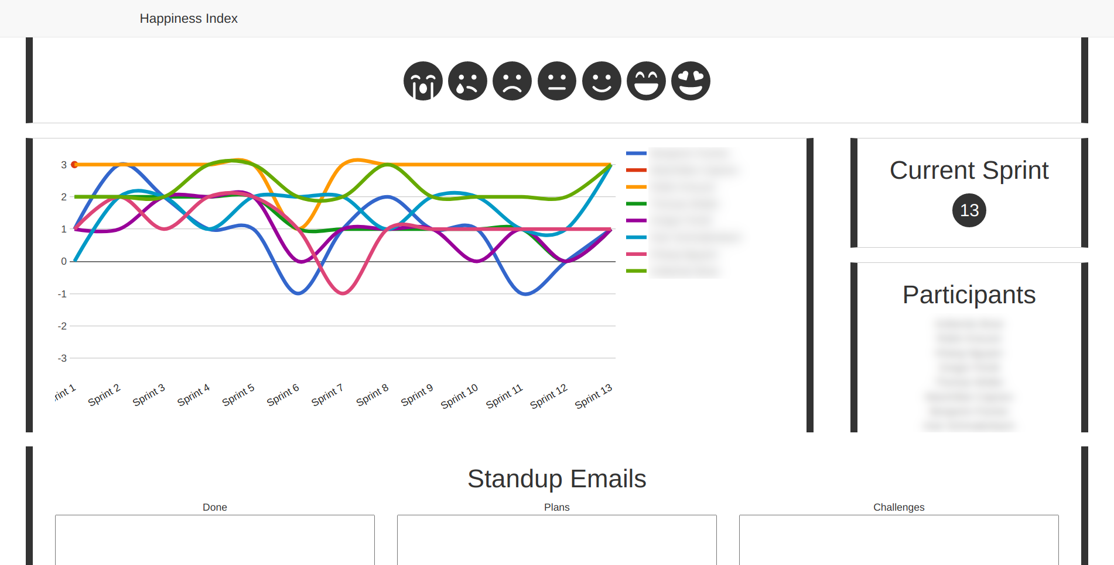
Happiness Index

Slide 11
5. Sprint Planning
This (now possibly new) sprint’s product owner
  Reprioritize product backlog items, if necessary, on-the-fly
  Work through top-prioritized backlog items one-by-one until finished
    For each product backlog item, explain it, ask developers to estimate and commit
    You are finished, if the team does not want to take on more backlog items
Software developer
  Estimate size of each backlog item using planning poker
  After planning, commit to backlog items put into sprint backlog
Everyone
  Make sure roles for sprint are clear to everyone

Slide 12
Story Points
Story point
  An arbitrary numeric measure of size of a given feature
Properties
  Is a measure of size, not of effort or duration
  Measured in non-linear increments, forcing choice
  Is socially agreed upon, depends on team estimation history
  Is independent of a particular person (and their skills)
  Is mapped to time using the team's velocity (development speed)
Points | Meaning
0 | No size
1 | Trivial size
2 | Small size
3 | Medium size
5 | Large size
8 | Very large size
13 | Too large (size)

Slide 13
Flow Diagram for Sprint Planning [1]
start
Product owner
picks feature
Each developer
deliberates
Developers re-
view total effort
Product owner
reads story
Each developer
plays card
no
Done?
yes
yes
end
Product owner
explains story
Agreement?
Product owner
adjusts backlog
no
Developers
discuss story
[1] A simple planning poker cards replacement can be found in the planning documents

Slide 14
6. Meeting After-work
This sprint’s product owner
  Update planning documents to consistent state
    Clean up product and sprint backlog
    Ensure feature archive is current
    Update release plan with actual effort for sprint
Software developers
  Plan programming tasks (1 feature = 1+ tasks)
    Agree on which developer(s) work(s) on which tasks
    If pair programming, ensure you document the pair
    May happen right after meeting or during sprint
This sprint’s Scrum master
  Work on resolving impediments during sprint
  Document resolutions in impediments backlog

Slide 15
Thank you! Questions?
dirk.riehle@fau.de – https://oss.cs.fau.dedirk@riehle.org – https://dirkriehle.com – @dirkriehle
DR

Slide 16
Legal Notices
License
  Licensed under the CC BY 4.0 International license
Copyright
  © 2010-2022 Dirk Riehle, some rights reserved

